Slide 1
Object Oriented Programming Using Java 1.8 (Spider)

Slide 2
Evaluation Strategy
Duration
Evaluation
Theory Exam
Lab Exam
Internals
Reference Books
: 90 Hours(46 Theory + 44 Lab)
: Total 100 marks
: 40% (CCEE)
: 40% (End-Module Exam)
: 20%
:
1. Java, The Complete | Reference – Herbert Schildt
2. Core Java Volume I | and II – Cay S. Horstmann
3. Java 8 Programming | Black Book – D.T. Editorial | Services
4. Object Oriented Analysis
Reference links :
and Design with Applications – Grady Booch
https://docs.oracle.com/javase/tutorial/
https://dev.java/
https://docs.oracle.com/javase/8/docs/api/

Slide 3
Contents
Language, Technology and Platform
History of Java programming language
Java version history
Java Software Development Kit

Slide 4
Classification of Programming Languages
Machine level programming language
Binary language
Low level programming language
Assembly programming language
High level programming language
Procedure oriented programming languages
Algol, Fortran, COBOL, Pascal, C etc.
Object oriented programming languages
Simula, Smalltalk, C++, Java, C#, Go, Python etc.
Object based programming languages
Ada, Java Script, Action Script, VB Script, Visual Basic etc.
Functional programming languages
Haskell, Lisp, F#, Scala, Clojure, Ocaml, Python, C#, C++, Java

Slide 5
“Hello World” Application using Machine Language
Here is the “Hello World!!” program in binary:
01001000 | 01100101 | 01101100 | 01101100
01101111 | 00100000 | 01010111 | 01101111
01110010 | 01101100 | 01100100 | 00100001
00100001
Advantages of machine-level language:
Very fast execution times
Complete control over the
No need for a compiler or
computer's hardware interpreter
Limitations of machine-level language
Very difficult to read and write
Specific to a particular computer architecture, making it non-portable
Requires a deep understanding of the underlying hardware

Slide 6
“Hello World” Application using Low Level Language
Here is the "Hello World!!" program in x86 assembly language:
section .data
msg db 'Hello World!!',0
section .text
global _start
_start:
; Write the string to stdout mov eax, 4 ; System call
for "write"
mov | ebx, | 1 | ; | File descriptor for stdout
mov | ecx, | msg | ; | Pointer to the message
mov | edx, | 13 | ; | Length of the message
int | 0x80 |  | ; | Call the kernel
; Exit the program with a status of 0
mov | eax, | 1 | ; | System | call for "exit"
xor | ebx, | ebx | ; | Status | code (0 = success)
int 0x80
; Call the kernel

Slide 7
Advantages and Limitations of Low Level Language
Advantages of low-level languages include:
Faster execution times than high-level languages
Direct access to the computer's hardware
More portable than machine-level language
Limitations of low-level languages include:
Still difficult to read and write compared to high-level languages
Can be error-prone due to the need for manual memory management
Not as user-friendly as high-level languages

Slide 8
“Hello World” Application using High Level Language
Here is the “Hello World!!” program in Python:
print("Hello, world!")
Advantages of high-level language:
Easy
Less
More
to read and write
error-prone due to built-in error checking and automatic memory management portable than machine-level and low-level languages
Limitations of high-level language
Slower execution times than low-level languages
Less control over the computer's hardware than low-level languages
More memory-intensive than low-level languages

Slide 9
What is Language?
Language is a system of communication that allows humans to convey meaning to each other through the use of symbols, such as words, gestures, and facial expressions.
In the context of computer science, programming languages are used to write software programs that can be executed by computers.
In General programming languages contains:
Syntax and Semantics
Tokens(Identifier, Keyword, Constant, operator, Separator)
Data Types
Comments
Built in unique features
Even though languages are used to implement business logic, they can be used to create applications too:
Console User Interface(CUI) / Command Line Interface(CLI) Application
Graphical User Interface(GUI) application
Library
Application(.lib/.dll/.jar)
Languages:
Java, C#, Python, GO etc.
Example of
C, C++,

Slide 10
What is Technology?
Technology refers to the tools and techniques used to create
and manipulate information. In
Simple words, we can develop application using technology.
Example:
Java
Artificial Intelligence (AI)
Blockchain
Augmented Reality (AR)
Internet of Things (IoT)
Cloud Computing
Note: Every language can be considered as technology but every technology can not be considered as language.

Slide 11
What is Platform?
A platform is the hardware or software environment in which a program runs.
Most platforms can be described as a combination of the operating system and underlying hardware:
Microsoft Windows
Linux
Mac OS
Android
Software-only platforms are the applications that runs on top of other hardware-based platforms:
Java
Microsoft .NET

Slide 12
History of Java Programming Language
Java is high-level, statically type checked, Object-oriented as well as Functional programming language.
Java
Code
Java
language is both name of the Java
technology as well as platform. was “Green” Project.
(“Green Team”) James Gosling, Patrick Naughton, Chris Warth, Ed Frank,
was developed by
and Mike Sheridan at Sun Microsystems, which was later acquired by Oracle Corporation(2010).
The name "Green" was chosen because the team wanted to emphasize that their goal was to
create an environmentally-friendly language that would allow programs to run efficiently on a
variety of devices, including small handheld devices and large servers.
Green Team started working on “Green Project” in 1991 and first public version released in 1996.
In fact, the original name for Java was "Oak", but it was changed to "Java" because another company had already registered the name "Oak" for their product.
Java's slogan is "Write Once, Run Anywhere" (sometimes abbreviated as "WORA").
The standardization of the Java language is overseen by the Java Community Process (JCP).
“*7” is the first project delivered by Green Team.
An extremely intelligent TV remote control.
Reference to read a short history of Java: Core Java Volume I

Slide 13
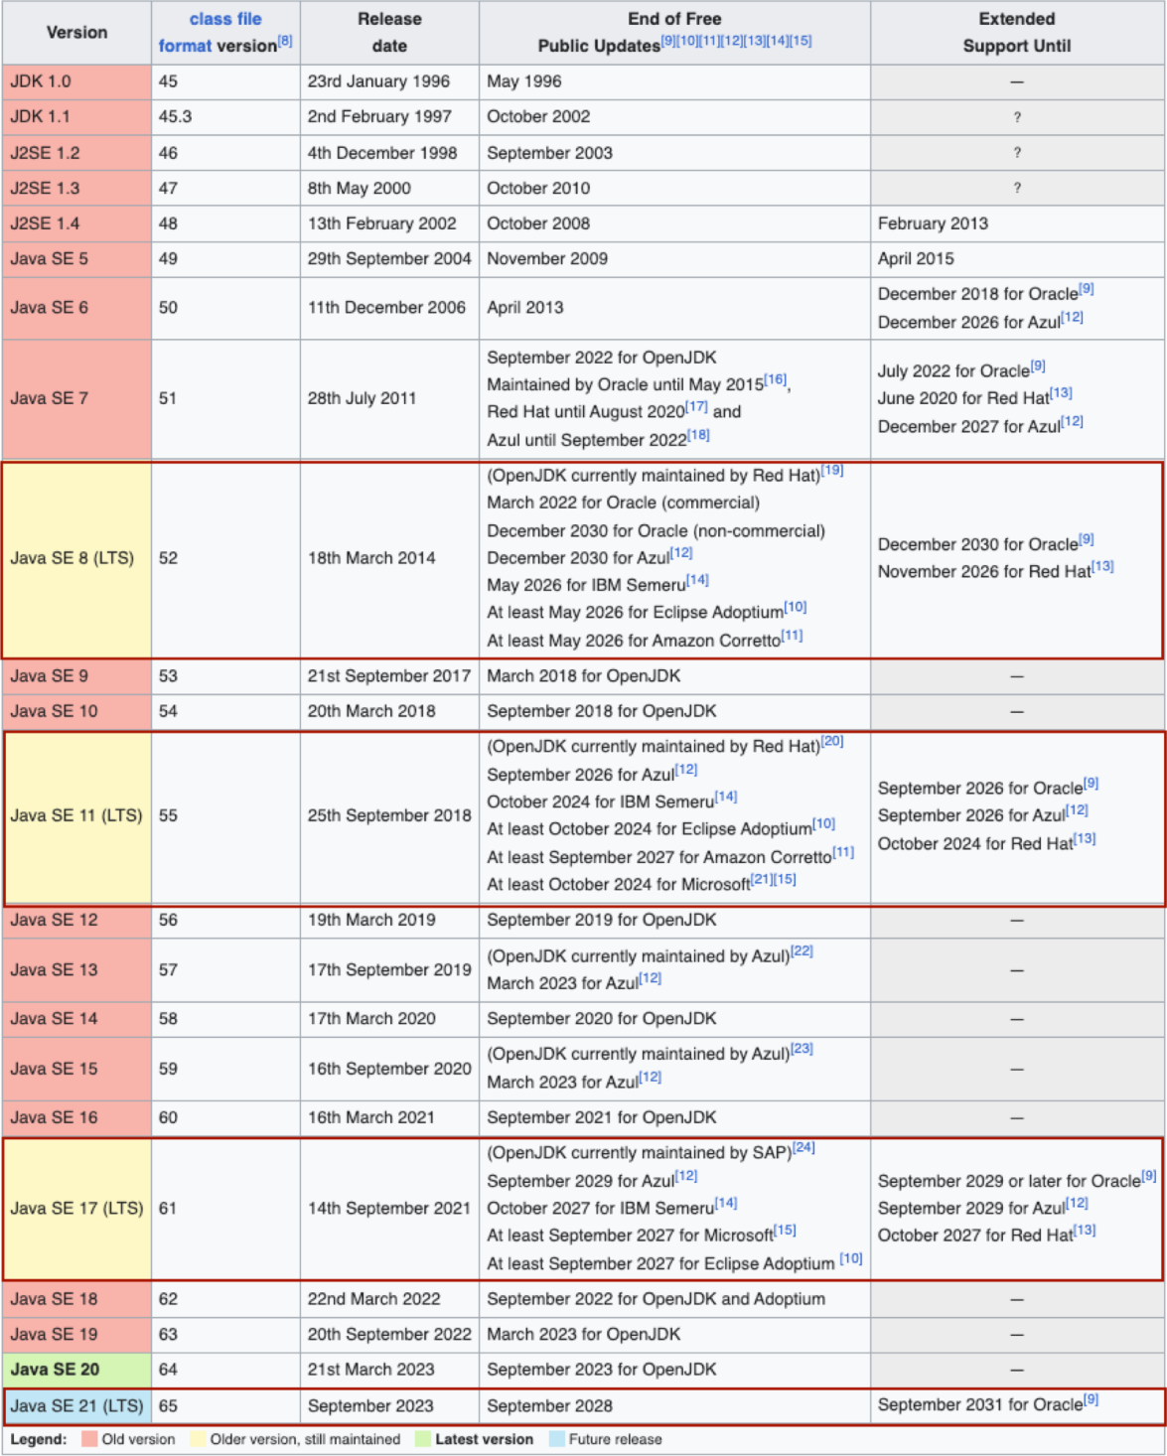
Java Version History (https://en.wikipedia.org/wiki/Java_version_history)

Slide 14
Java Code Names
Code names are used by developers the development process.
and companies to refer
to different versions of Java during
JDK 1.1: Sparkler
J2SE
J2SE
J2SE
J2SE
Java
Java
Java
Java
1.2:
1.3:
1.4:
5.0:
Playground Kestrel Merlin Tiger
SE 6: Mustang
SE 7: Dolphin
SE 8: Spider
SE 9: Project Jigsaw SE
SE SE SE SE
SE SE SE
Java
Java
Java
Java
Java
Java
Java
Java
10: Project
11: Project
12: Project
13: Project
14: Project
15: Project
16: Project
17: Project
Valhalla Amber Skara ZGC
Panama
Loom Metropolis Panama 2.0

Slide 15
JLS and JSR
JLS stands for Java Language Specification.
It is a document that defines the syntax, semantics, and language.
Reference: https://docs.oracle.com/javase/specs/
JSR stands for Java Specification Request.
It is a formal proposal for adding new features or making changes
JSRs are submitted by individuals, organizations, or companies to (JCP) for review and approval.
Reference: https://jcp.org/en/jsr/detail?id=336
behavior of the Java programming
to the Java platform.
the Java Community Process

Slide 16
Editions of Java Platform
Java SE
Java Standard Edition( also called as Core Java)
It is designed for developing and running desktop, server, and standalone applications.
It includes the core Java API and provides a foundation for building Java applications.
Java EE
Java Enterprise Edition( also called as Web / Advanced / Enterprise Java )
It is designed for building web applications and web services.
It includes the Java Servlet API, Java Server Pages (JSP), and Enterprise JavaBeans
(EJB).
3. Java ME
Java Micro Edition.
It is designed for developing applications for resource-constrained devices such as PDAs, and other embedded systems.
It includes a subset of the Java SE APIs and provides a smaller footprint than Java SE.
mobile
phones,
4. Java Card
It is designed for building
It includes a subset of the card applications.
smart card applications.
Java ME APIs and provides security and cryptographic features for smart

Slide 17
Software Development Kit
SDK = Development Tools + Documentation + Supporting Libraries + Execution Environment.
JDK = Java Development Tools + Java Docs + rt.jar + Java Virtual Machine.
Java Development Tools: javac, java, javap, javadoc, etc.
Java Docs: HTML pages, which contains help of Core Java API
rt.jar: It contains core Java API
Java Virtual Machine: It is abstract computer which manages execution
of bytecode.
JDK is a platform dependent software that we can download from oracle site.
Developer must install JDK to develop Java application.
JRE = rt.jar + Java Virtual Machine.
JRE is platform dependent software that we can download from oracle site.
To run Java application on Client’s machine we must install/deploy JRE.
JVM = Java Virtual Machine
The JVM is responsible for interpreting the bytecode and translating it into
machine code
that can be executed by the underlying operating system. It also provides memory management, security, and other runtime services necessary for executing Java applications.
Reference: https://www.oracle.com/in/java/technologies/downloads/

Slide 18
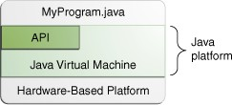
Components of Java Platform
The Java platform has two components:
The Java Virtual Machine
The Java Application Programming
Interface
(API)
Reference: https://docs.oracle.com/javase/tutorial/getStarted/intro/definition.html

Slide 19
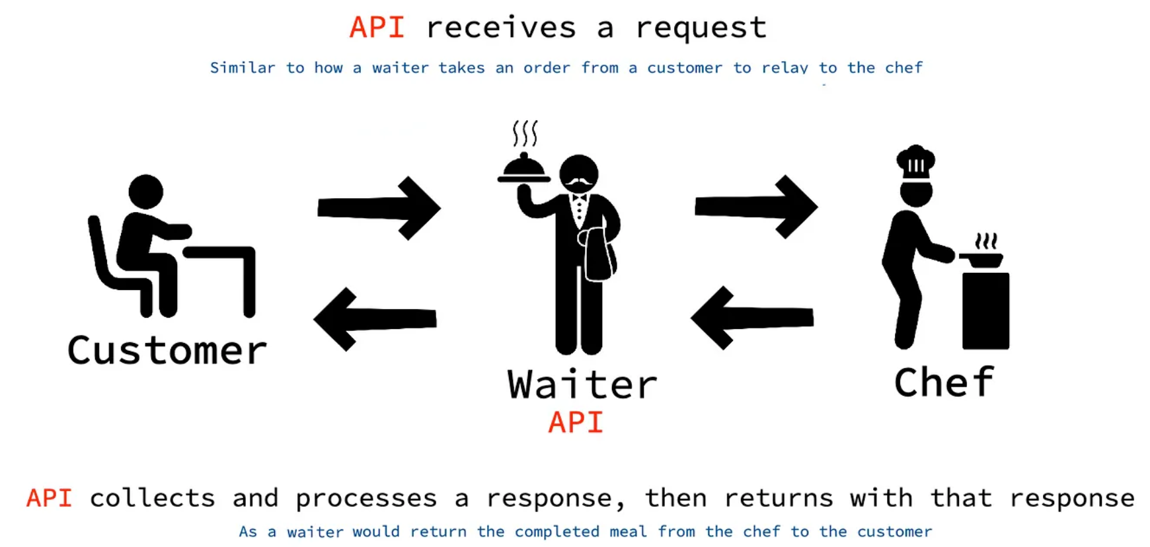
Application Programming Interface

Slide 20
What is next?
main method
meaning of "System.out.println“
print, println and printf
Java Comments
Primitve & Non Primitive types
Initialization and Assignment
Narrowing & Widening
wrapper class
Boxing & Unboxing
NumberFormatException
Commandline arguments
Assignment to do:
- Assignment 1

Slide 21
Packages in Java
Packages can contains:
Sub package
Interface
Nested Type
Constant Fields
Abstract Methods
Default Methods
Static Interface Methods
3. Class
Nested Types( Interface / Class / Enum )
Fields
Constructor
Method
4. Enum
5. Exception
6. Error
7. Annotation Type

Slide 22
Modifiers in Java
PUBLIC
PRIVATE
PROTECTED
STATIC
FINAL
SYNCHRONIZED
VOLATILE
TRANSIENT
NATIVE
INTERFACE
ABSTRACT
STRICT
Reference: https://docs.oracle.com/javase/8/docs/api/java/lang/reflect/Modifier.html

Slide 23
Main Method & Modifiers
Access Modifiers: Modifiers which are used to control visibility of members of the class is called access modifier.
private
Package level private( also called as default )
protected
Public
In java, main method is considered as entry point method. With the help of main thread, JVM invoke main method.
Syntax:
public static void main(String args[] )
public static void main(String[] args )
public static void main(String... args )
We can define main method inside class as well as interface.
Reference: https://docs.oracle.com/javase/tutorial/getStarted/application/index.html

Slide 24
Writing and Executing a Simple Java Program Writing and Executing a Simple Java Program
1. Create a class
2. Write main method inside class
3. Write logic
4. Compile using 'javac'
5. Execute using 'java'

